Slide 1
Marquee Catering Menu University Parks

Slide 2
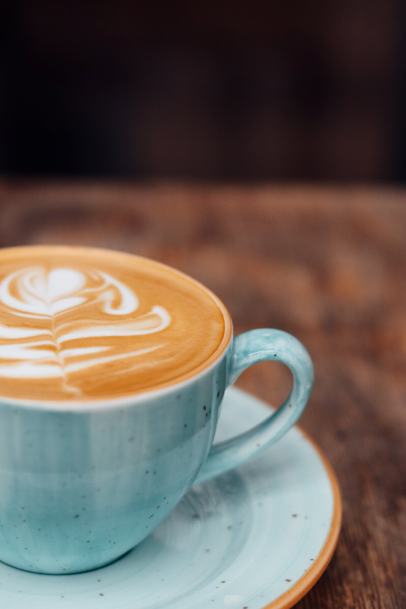
DETAILS
Please note all orders should be made via Planon
Orders may include
Tea & coffee stations
Individually wrapped bakery
Customised individual boxed lunches
Individually wrapped sweet treats
Individual soft drinks
Bespoke options available on request

Slide 3
MENU
REFRESHMENTS
HOT BEVERAGE (minimum 10 people)
SIMPLE BEVERAGE
Tea, coffee £1.40
Tea, coffee, individually wrapped biscuits £2.20
INDULGENT AND HEALTHY TREATS
Tea, coffee, homemade cookie (individually wrapped) (V) £3.20
Tea, coffee, mini Danish pastries (individually wrapped) (V) £3.30
Tea, coffee, tray bake (individually wrapped) (V) £3.55
COLD BEVERAGE
Still & sparkling water, 500ml (plastic bottle) £1.40
Canned soft drinks, 330ml £1.70
Elderflower presse, 275ml (glass bottle) £3.00
Fairtrade Orange juice, 500ml (plastic bottle) £3.25
Fairtrade Apple Juice, 500ml (plastic bottle) £3.25
LITTLE EXTRAS
Add a little something to your refreshment break
Handcrafted potato crisps £1.10
Handcrafted root vegetable crisps £1.10
Individual piece of fruit (apple, banana, orange) £1.00
Cut fruit pot £2.75
Individually wrapped packet of biscuits £1.00
Nakd bars (Peanut delight, Cocoa orange, Cashew Cookie £1.75
Home-baked cookie (individually wrapped) £2.10
Tray bake (individually wrapped) £2.55
CONFERENCE BREAKFAST (served in a box) £8.65
Butter croissant (v)
Selection of mini Danish pastries (v)
Butter, and fruit preserves
Freshly brewed coffee or tea
Bottled still water

Slide 4
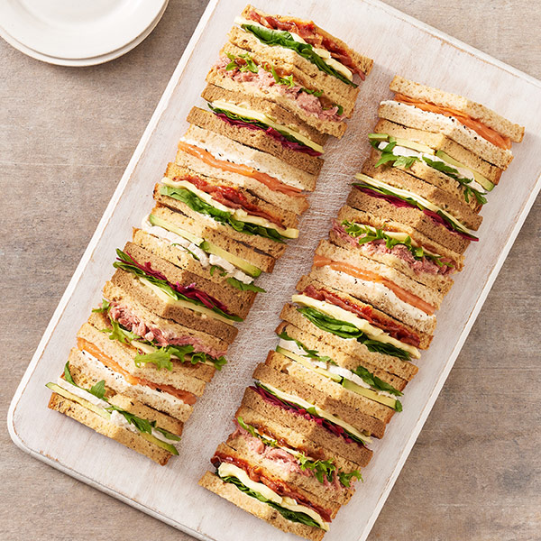
LUNCH OPTIONS
TRADITIONAL WORKING LUNCH - £9.95
Provided with disposable boxes and napkins
Choose one sandwich
Ham, mature cheddar & pickle
Chicken mayo & lettuce
Egg mayo & lettuce
Egg mayo & cress
Red pepper, houmous & rocket (vg)
Choice of Tyrrells crisps
Lightly salted
Salt & Vinegar
Sweet Chilli
Savoury popcorn
Dessert
Fresh cut fruit bowl
Choose one drink
Fairtrade apple juice
Fairtrade orange juice
Life still water
Life sparkling water
£9.95

Slide 5
LUNCH OPTIONS
OCCASIONS WORKING LUNCH - £15.75
Provided with disposable boxes, napkins and cutlery
Choose one sourdough baguette
Pastrami, emmental & mustard mayo
Smoked salmon, lemon cream cheese & dill
Bacon, brie & cranberry
Red pepper, houmous & rocket (ve)
Choose two side dishes
Chicken yakatori skewer
Beetroot & lentil spiced falafel
Pork & chorizo sausage roll
Mushroom garlic & tarragon roll
Choice of Tyrrells crisps
Lightly salted
Salt & Vinegar
Sweet Chilli
Savoury popcorn
Dessert
Fresh cut fruit bowl
Choose one drink
Fairtrade apple juice
Fairtrade orange juice
Life still water
Life sparkling water

Slide 6
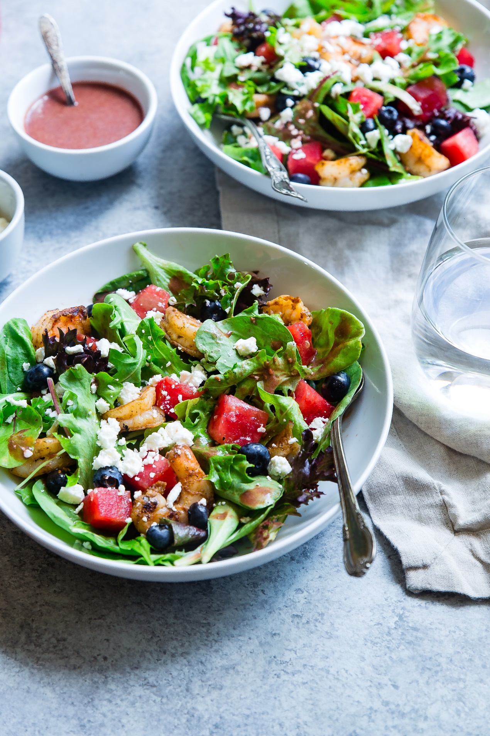
LUNCH OPTIONS
SPECIAL OCCASIONS WORKING LUNCH - £18.90
Provided with disposable boxes, napkins and cutlery
Choose one sourdough baguette
Pastrami, emmental & mustard mayo
Smoked salmon, lemon cream cheese & dill
Bacon, brie & cranberry
Red pepper, houmous & rocket (ve)
Choose one salad
Classic Greek salad
Falafel, harrisa roast vegetables & grain salad
Chicken & Bacon Caesar salad with herbed croutons
Choose two side dishes
Lamb kofta lollipops
Red onion & sweet potato bhaji
Lemon, thyme, asparagus & blue cheese tart
Pesto & mozzarella arrancini
Choose one dessert
Luxury Lemon & Ginger traybake
Lemon tart with mixed berry compote
Chocolate fudge slice
Fresh cut fruit bowl
Choose one drink
Fairtrade apple juice
Fairtrade orange juice
Life still water
Life sparkling water

Slide 7
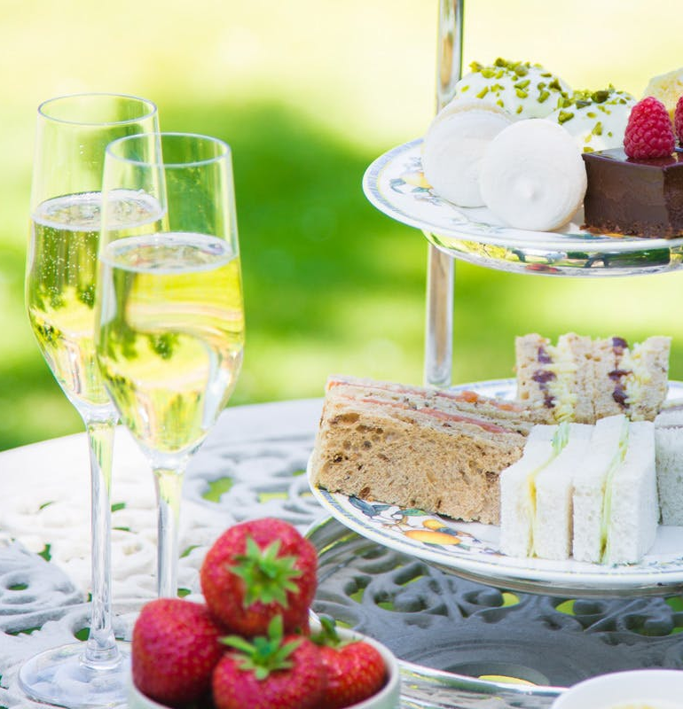
AFTERNOON TEA
Minimum order ten people
Provided with disposable boxes, napkins and cutlery
Cream Tea - £5.00 per person
A duo of freshly baked mini scones with clotted cream, preserve and freshly brewed coffee and tea
High Tea - £10.00 per person
Freshly brewed coffee and tea, finger sandwiches to include smoked salmon, cucumber, and cheese and tomato, a duo of freshly baked mini scones with preserve and clotted cream and your choice of one of the following; mini macaroons, chocolate cake or Victoria sponge
Make it Royal!
Add a glass of fizz to your afternoon tea for just £4.90 per person!

